Slide 1


Edwin Omol
11/12/2023

Slide 2

Outline
Executive Summary
Introduction
Methodology
Results
Conclusion
Appendix

Slide 3
Executive Summary
The aim of this project is to Analyze SpaceX launch data to predict rocket landing attempts based on various factors. The data herein was collected using SpaceX REST API (/launches/past) and Web scraping Wiki pages (Falcon 9 launch records). Data processing included: JSON normalization using json_normalize, Functions for booster, launchpad, payload, and core data extraction. Data filtering entailed Selective sampling to retain Falcon 9 launches and Handling Null Values included Calculate mean of 'PayloadMass' to replace null values, Retain null values in 'LandingPad' for one-hot encoding. In Conclusion Clean dataset for visualization and analysis, providing insights into SpaceX launch patterns and influencing factors. Reliable handling of null values ensures data integrity for further analysis and modeling.

Slide 4
Introduction
Project Background and Context: In the realm of space exploration, understanding the intricacies of rocket launches is paramount. This project delves into the analysis of SpaceX launch data, seeking profound insights into the factors influencing rocket landing attempts. Utilizing data obtained from SpaceX REST API and web scraping of Falcon 9 launch records, the endeavor is set against the backdrop of the evolving space industry, where precision and predictive capabilities play a pivotal role.
Problems Addressed: The project seeks to address key challenges in predicting rocket landing attempts by leveraging SpaceX launch data. These challenges include the need for a meticulous cleaning and processing of diverse data sources, such as the SpaceX REST API and Wiki pages. Additionally, the project addresses the intricacies of null value handling and selective data filtering, aiming to create a refined dataset for in-depth visualization and analysis. Ultimately, the project aims to contribute valuable insights to the understanding of SpaceX launch patterns and the various factors influencing the success of rocket landings.

Slide 5

Section 1

Slide 6
Methodology
The methodology for the SpaceX Launch Data Analysis project involved a dual-pronged data collection strategy, encompassing the extraction of comprehensive information from the SpaceX REST API (/launches/past) and web scraping Falcon 9 launch records from Wiki pages. Meticulous data wrangling techniques, including JSON normalization and specialized functions for booster, launchpad, payload, and core data extraction, ensured the refinement of the dataset. Further processing included selective sampling of Falcon 9 launches and strategic handling of null values in critical columns. Exploratory Data Analysis (EDA) employed a combination of visualization techniques and SQL queries to uncover patterns and relationships. The project embraced interactive visual analytics with tools like Folium and Plotly Dash, allowing dynamic exploration. The predictive analysis phase involved building, tuning, and evaluating classification models for predicting rocket landing attempts, with a focus on hyperparameter optimization for optimal performance. Overall, this comprehensive methodology aimed to unveil meaningful insights into SpaceX launch patterns and contribute to a deeper understanding of the factors influencing rocket landing attempts.

Slide 7
Data Collection
The data collection process for the SpaceX Launch Data Analysis project was orchestrated through a dual approach. Firstly, leveraging the SpaceX REST API (/launches/past), a systematic series of GET requests were executed, authenticating the API, targeting the specific endpoint, and handling JSON responses. Complementary to this, Falcon 9 launch records were extracted via web scraping from Wiki pages, involving HTML parsing and meticulous data extraction from tables. The subsequent integration of API and web-scraped data ensured a unified dataset. Throughout these processes, rigorous documentation practices were maintained, encompassing API details and scraping procedures, alongside validation steps to ensure data integrity. Flowcharts visually articulate the sequential steps, highlighting the systematic nature of the process and ensuring transparency and replicability.

Slide 8

Section 2

Slide 9
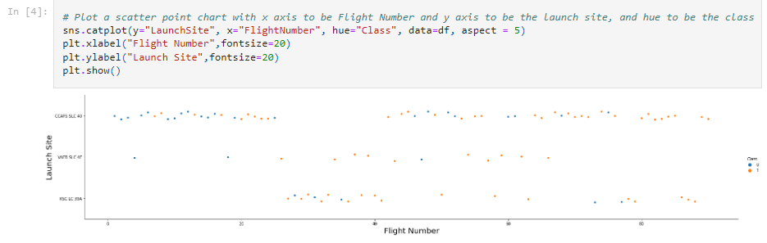
Flight Number vs. Launch Site

Slide 10
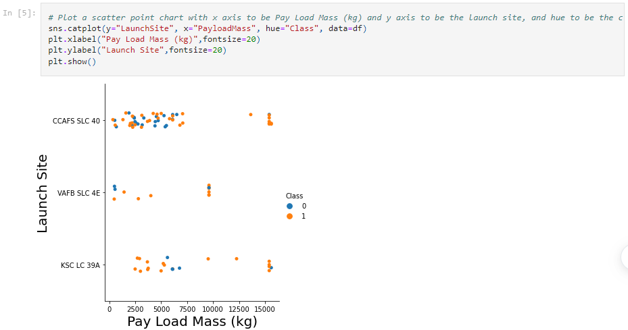
Payload vs. Launch Site

Slide 11
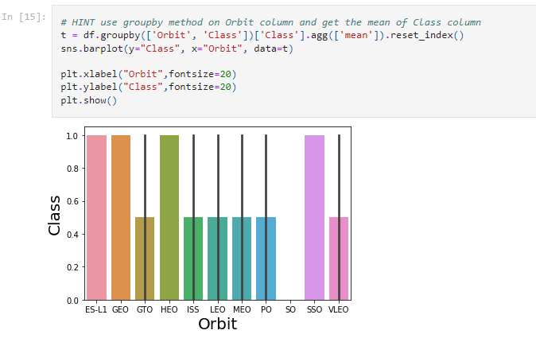
Success Rate vs. Orbit Type

Slide 12
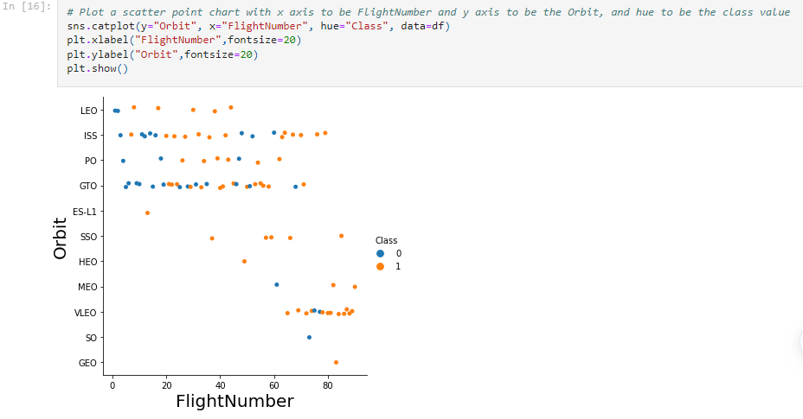
Flight Number vs. Orbit Type

Slide 13
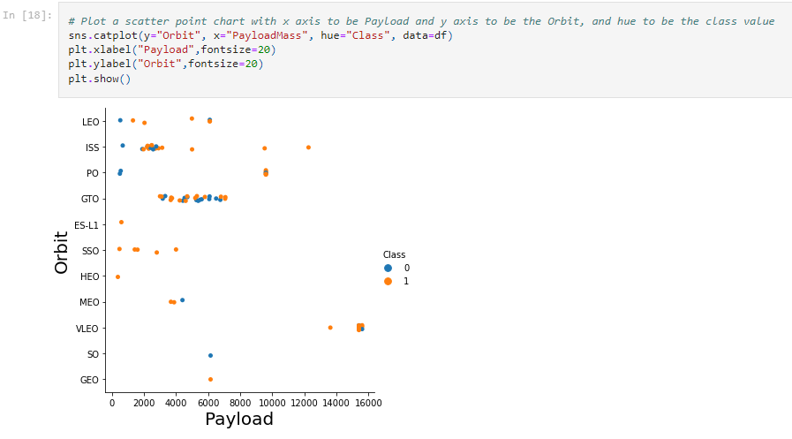
Payload vs. Orbit Type

Slide 14
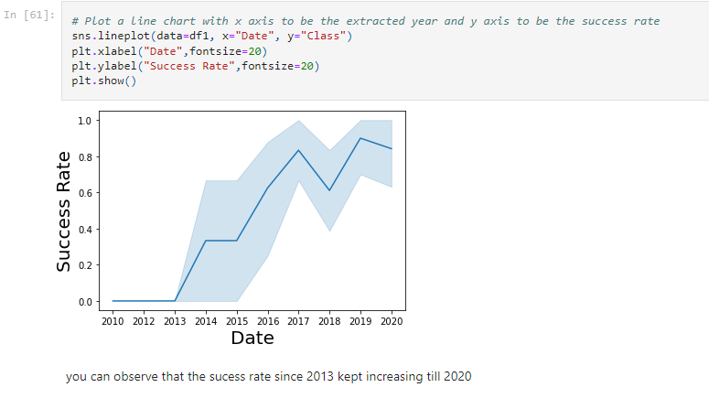
Launch Success Yearly Trend

Slide 15
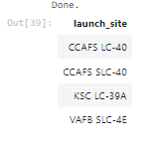
All Launch Site Names

Slide 16
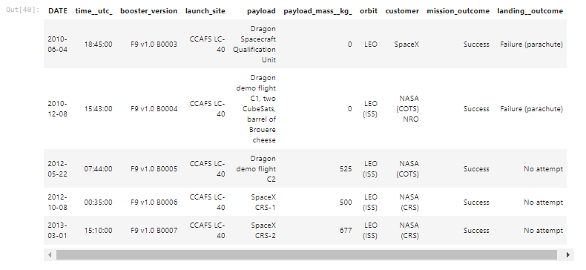
Launch Site Names Begin with 'CCA'

Slide 17
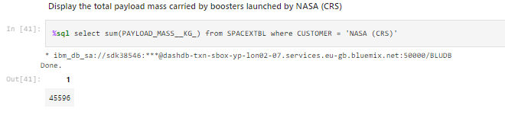
Total Payload Mass

Slide 18
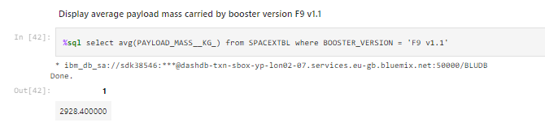
Average Payload Mass by F9 v1.1

Slide 19
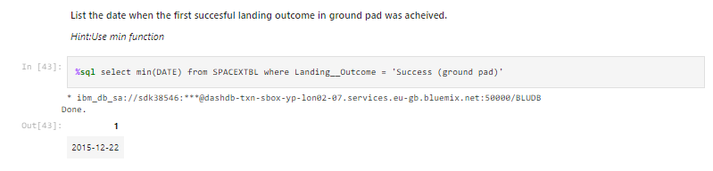
First Successful Ground Landing Date

Slide 20
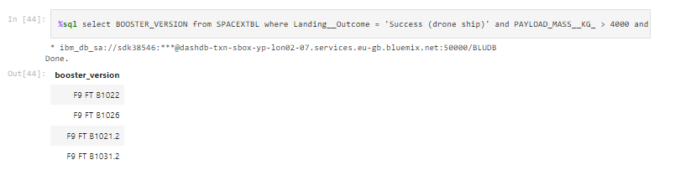
Successful Drone Ship Landing with Payload between 4000 and 6000

Slide 21
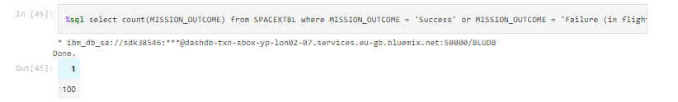
Total Number of Successful and Failure Mission Outcomes

Slide 22
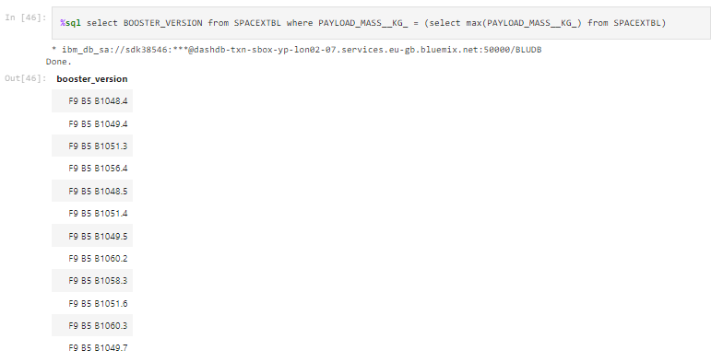
Boosters Carried Maximum Payload

Slide 23
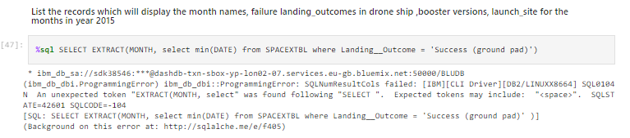
2015 Launch Records

Slide 24
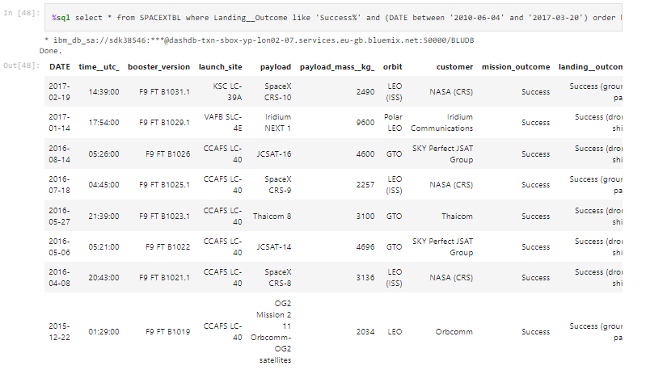
Rank Landing Outcomes Between 2010-06-04 and 2017-03-20

Slide 25

Section 3

Slide 26
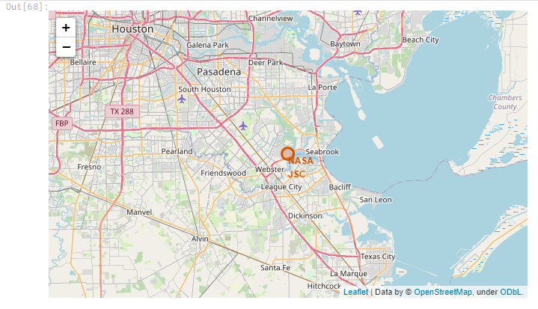
Folium Map object, with an initial center-NASA Johnson Space Center at Houston, Texas

Slide 27
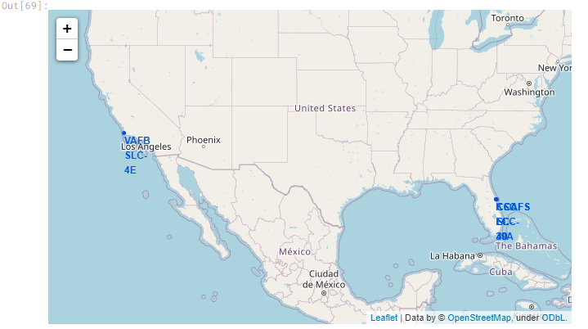
Folium Map with folium.Circle and folium.Marker

Slide 28
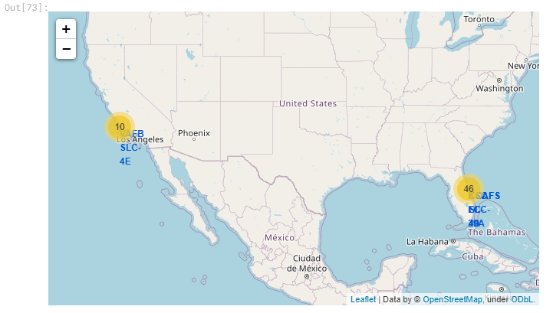
Folium Map launch_sites dataframe

Slide 29

Section 4

Slide 30
<Dashboard Screenshot 1>
Replace <Dashboard screenshot 1> title with an appropriate title
Show the screenshot of launch success count for all sites, in a piechart
Explain the important elements and findings on the screenshot

Slide 31
<Dashboard Screenshot 2>
Replace <Dashboard screenshot 2> title with an appropriate title
Show the screenshot of the piechart for the launch site with highest launch success ratio
Explain the important elements and findings on the screenshot

Slide 32
<Dashboard Screenshot 3>
Replace <Dashboard screenshot 3> title with an appropriate title
Show screenshots of Payload vs. Launch Outcome scatter plot for all sites, with different payload selected in the range slider
Explain the important elements and findings on the screenshot, such as which payload range or booster version have the largest success rate, etc.

Slide 33

Section 5

Slide 34
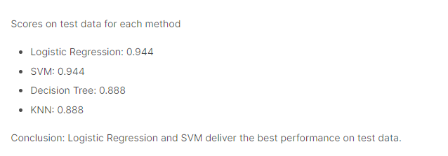
Classification Accuracy

Slide 35
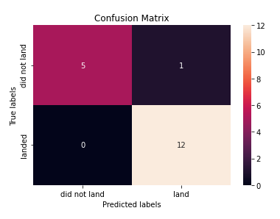
Confusion Matrix

Slide 36
Conclusions
In conclusion, the SpaceX Launch Data Analysis project successfully navigated the intricacies of collecting, wrangling, and analyzing diverse datasets to derive valuable insights into the complex realm of rocket launches. Through a meticulous data collection process, we harnessed the power of the SpaceX REST API and web scraping techniques to compile a comprehensive dataset. The systematic data wrangling methodologies, including JSON normalization and specialized functions, ensured the refinement and harmonization of the dataset. Exploratory Data Analysis (EDA) using visualization and SQL uncovered nuanced patterns, providing a foundation for further analyses. Interactive visual analytics with Folium and Plotly Dash enhanced our understanding of SpaceX launch patterns. The implementation of classification models in predictive analysis allowed us to make informed predictions about rocket landing attempts. The project's robust methodology, from data collection to predictive modeling, facilitated a thorough examination of SpaceX launch data, contributing valuable insights to the broader understanding of space exploration dynamics.

Slide 37
Appendix
import requests
from bs4 import BeautifulSoup
import pandas as pd
static_url = "https://en.wikipedia.org/w/index.php?title=List_of_Falcon_9_and_Falcon_Heavy_launches&oldid=1027686922"
# Send a GET request to the URL
response = requests.get(static_url)
# Check if the request was successful (status code 200)
if response.status_code == 200:
print("Request successful")
# Create a BeautifulSoup object from the HTML content
soup = BeautifulSoup(response.text, 'html.parser')
# Find all tables on the page
html_tables = soup.find_all('table', "wikitable plainrowheaders collapsible")
# Check if there are at least three tables
if len(html_tables) >= 3:
# Select the third table
third_table = html_tables[2]

Slide 38


